Slide 1
RESPIRATORY SYSTEM

Slide 2
Respiratory System
Consists of the respiratory and conducting zones
Respiratory zone
  Site of gas exchange
  Consists of bronchioles, alveolar ducts, and alveoli
Conducting zone
  Provides rigid conduits for air to reach the sites of gas exchange
  Includes all other respiratory structures (e.g., nose, nasal cavity, pharynx, trachea)
Respiratory muscles – diaphragm and other muscles that promote ventilation

Slide 3
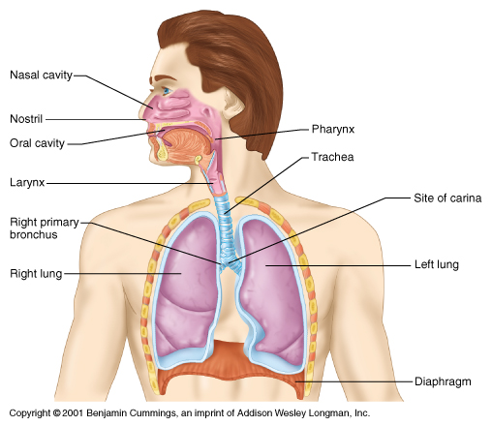
Respiratory System
Figure 21.1

Slide 4
Major Functions of the Respiratory System
To supply the body with oxygen and dispose of carbon dioxide
Respiration – four distinct processes must happen
  Pulmonary ventilation – moving air into and out of the lungs
  External respiration – gas exchange between the lungs and the blood
  Transport – transport of oxygen and carbon dioxide between the lungs and tissues
  Internal respiration – gas exchange between systemic blood vessels and tissues

Slide 5
Gross Anatomy of the Lungs
Lungs occupy all of the thoracic cavity except the mediastinum
  Root – site of vascular and bronchial attachments
  Costal surface – anterior, lateral, and posterior surfaces in contact with the ribs
  Apex – narrow superior tip
  Base – inferior surface that rests on the diaphragm
  Hilus – indentation that contains pulmonary and systemic blood vessels

Slide 6
Lungs
Cardiac notch (impression) – cavity that accommodates the heart
Left lung – separated into upper and lower lobes by the oblique fissure
Right lung – separated into three lobes by the oblique and horizontal fissures
There are 10 bronchopulmonary segments in each lung

Slide 7
Blood Supply to Lungs
Lungs are perfused by two circulations: pulmonary and bronchial
Pulmonary arteries – supply systemic venous blood to be oxygenated
  Branch profusely, along with bronchi
  Ultimately feed into the pulmonary capillary network surrounding the alveoli
Pulmonary veins – carry oxygenated blood from respiratory zones to the heart

Slide 8
Bronchial Circulation
Bronchial arteries – provide systemic blood to the lung tissue
  Arise from aorta and enter the lungs at the hilus
  Supply all lung tissue except the alveoli
Bronchial veins anastomose with pulmonary veins
Pulmonary veins carry most venous blood back to the heart

Slide 9
Breathing
Breathing, or pulmonary ventilation, consists of two phases
  Inspiration – air flows into the lungs
  Expiration – gases exit the lungs

Slide 10
Pressure Relationships in the Thoracic Cavity
Respiratory pressure is always described relative to atmospheric pressure
Atmospheric pressure (P_{atm})
  Pressure exerted by the air surrounding the body
  Negative respiratory pressure is less than P_{atm}
  Positive respiratory pressure is greater than P_{atm}
Intrapulmonary pressure (P_{alv}) – pressure within the alveoli
Intrapleural pressure (P_{ip}) – pressure within the pleural cavity

Slide 11
Pressure Relationships
Intrapulmonary pressure and intrapleural pressure fluctuate with the phases of breathing
Intrapulmonary pressure always eventually equalizes itself with atmospheric pressure
Intrapleural pressure is always less than intrapulmonary pressure and atmospheric pressure

Slide 12
Pressure Relationships
Two forces act to pull the lungs away from the thoracic wall, promoting lung collapse
  Elasticity of lungs causes them to assume smallest possible size
  Surface tension of alveolar fluid draws alveoli to their smallest possible size
Opposing force – elasticity of the chest wall pulls the thorax outward to enlarge the lungs

Slide 13
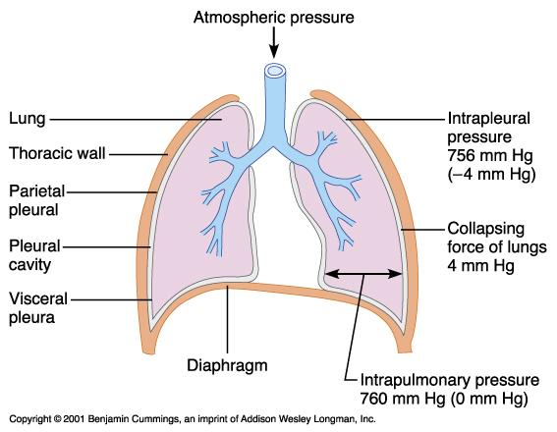
Pressure Relationships
Figure 21.12

Slide 14
Pulmonary Ventilation
A mechanical process that depends on volume changes in the thoracic cavity
Volume changes lead to pressure changes, which lead to the flow of gases to equalize pressure
ΔV → ΔP → F (flow of gases)

Slide 15
Boyle’s Law
Boyle’s law – the relationship between the pressure and volume of gases
P₁V₁ = P₂V₂
  P = pressure of a gas in mm Hg
  V = volume in cubic millimeters
  Subscripts 1 and 2 represent the initial and resulting conditions, respectively

Slide 16
Inspiration
The diaphragm and external intercostal muscles (inspiratory muscles) contract and the rib cage rises
The lungs are stretched and intrapulmonary volume increases
Intrapulmonary pressure drops below atmospheric pressure (−1 mm Hg)
Air flows into the lungs, down its pressure gradient, until intrapleural pressure = atmospheric pressure

Slide 17
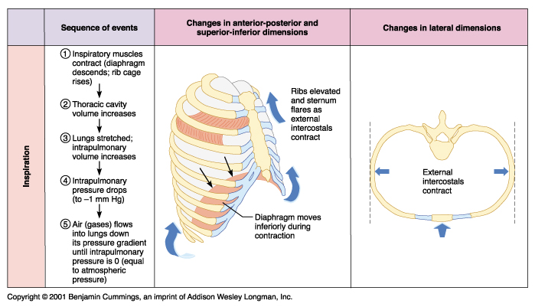
Inspiration
Figure 21.13.1

Slide 18
Expiration
Inspiratory muscles relax and the rib cage descends due to gravity
Thoracic cavity volume decreases
Elastic lungs recoil passively and intrapulmonary volume decreases
Intrapulmonary pressure rises above atmospheric pressure (+1 mm Hg)
Gases flow out of the lungs down the pressure gradient until intrapulmonary pressure is 0

Slide 19
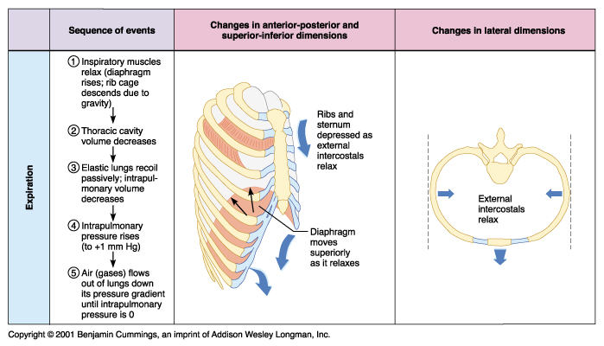
Expiration
Figure 21.13.2

Slide 20
Physical Factors Influencing Ventilation:
Airway Resistance
Friction is the major nonelastic source of resistance to airflow
The relationship between flow (F), pressure (P), and resistance (R) is:
_{F =} ΔP
      R

Slide 21
Physical Factors Influencing Ventilation: Airway Resistance
The amount of gas flowing into and out of the alveoli is directly proportional to ΔP, the pressure gradient between the atmosphere and the alveoli
ΔP = Δ (P_{atm} – P_{alv})
Gas flow is inversely proportional to resistance with the greatest resistance being in the medium-sized bronchi

Slide 22
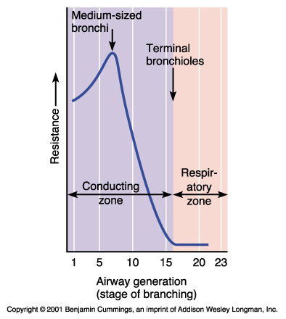
Physical Factors Influencing Ventilation: Airway Resistance
Figure 21.15

Slide 23
Airway Resistance
As airway resistance rises, breathing movements become more strenuous
Severely constricted or obstructed bronchioles:
  Can prevent life-sustaining ventilation
  Can occur during acute asthma attacks, which stops ventilation
Epinephrine release via the sympathetic nervous system dilates bronchioles and reduces air resistance

Slide 24
Alveolar Surface Tension
Surface tension – the attraction of liquid molecules for one another at a liquid-gas interface
The liquid coating the alveolar surface is always acting to reduce the alveoli to the smallest possible size
Surfactant, a detergent-like complex, reduces surface tension and helps keep the alveoli from collapsing

Slide 25
Lung Compliance
The ease with which lungs can be expanded
Specifically, the measure of the change in lung volume that occurs with a given change in transpulmonary pressure
Determined by two main factors
  Distensibility of the lung tissue and surrounding thoracic cage
  Surface tension of the alveoli

Slide 26
Factors That Diminish Lung Compliance
Scar tissue or fibrosis that reduces the natural resilience of the lungs
Blockage of the smaller respiratory passages with mucus or fluid
Reduced production of surfactant
Decreased flexibility of the thoracic cage or its decreased ability to expand
Examples include:
  Deformities of thorax
  Ossification of the costal cartilage
  Paralysis of intercostal muscles

Slide 27
Respiratory Volumes
Tidal volume (TV) – air that moves into and out of the lungs with each breath (approximately 500 ml)
Inspiratory reserve volume (IRV) – air that can be inspired forcibly beyond the tidal volume
(2100–3200 ml)
Expiratory reserve volume (ERV) – air that can be evacuated from the lungs after a tidal expiration (1000–1200 ml)
Residual volume (RV) – air left in the lungs after strenuous expiration (1200 ml)

Slide 28
Respiratory Capacities
Inspiratory capacity (IC) – total amount of air that can be inspired after a tidal expiration (IRV + TV)
Functional residual capacity (FRC) – amount of air remaining in the lungs after a tidal expiration
(RV + ERV)
Vital capacity (VC) – the total amount of exchangeable air (TV + IRV + ERV)
Total lung capacity (TLC) – sum of all lung volumes (approximately 6000 ml in males)

Slide 29
Dead Space
Anatomical dead space – volume of the conducting respiratory passages (150 ml)
Alveolar dead space – alveoli that cease to act in gas exchange due to collapse or obstruction
Total dead space – sum of alveolar and anatomical dead spaces

Slide 30
Alveolar Ventilation
Alveolar ventilation rate (AVR) – measures the flow of fresh gases into and out of the alveoli during a particular time
Slow, deep breathing increases AVR and rapid, shallow breathing decreases AVR
AVR | = | frequency | X | (TV – dead space)
(ml/min) |  | (breaths/min) |  | (ml/breath)

Slide 31
Basic Properties of Gases: Dalton’s Law of Partial Pressures
Total pressure exerted by a mixture of gases is the sum of the pressures exerted independently by each gas in the mixture
The partial pressure of each gas is directly proportional to its percentage in the mixture

Slide 32
Basic Properties of Gases: Henry’s Law
When a mixture of gases is in contact with a liquid, each gas will dissolve in the liquid in proportion to its partial pressure
The amount of gas that will dissolve in a liquid also depends upon its solubility
Various gases in air have different solubilities
  Carbon dioxide is the most soluble
  Oxygen is 1/20th as soluble as carbon dioxide
  Nitrogen is practically insoluble in plasma

Slide 33
Composition of Alveolar Gas
The atmosphere is mostly oxygen and nitrogen, while alveoli contain more carbon dioxide and water vapor
These differences result from:
  Gas exchanges in the lungs – oxygen diffuses from the alveoli and carbon dioxide diffuses into the alveoli
  Humidification of air by the conducting pathways
  The mixing of alveolar gas that occurs with each breath

Slide 34
External Respiration: Pulmonary Gas Exchange
Factors influencing the movement of oxygen and carbon dioxide across the respiratory membrane
  Partial pressure gradients and gas solubilities
  Matching of alveolar ventilation and pulmonary blood perfusion
  Structural characteristics of the respiratory membrane

Slide 35
Partial Pressure Gradients and Gas Solubilities
The partial pressure oxygen (PO₂) of venous blood is 40 mm Hg; the partial pressure in the alveoli is
104 mm Hg
  This steep gradient allows oxygen partial pressures to rapidly reach equilibrium (in 0.25 seconds), and thus blood can move three times as quickly (0.75 seconds) through the pulmonary capillary and still be adequately oxygenated

Slide 36
Partial Pressure Gradients and Gas Solubilities
Although carbon dioxide has a lower partial pressure gradient:
  It is 20 times more soluble in plasma than oxygen
  It diffuses in equal amounts with oxygen

Slide 37
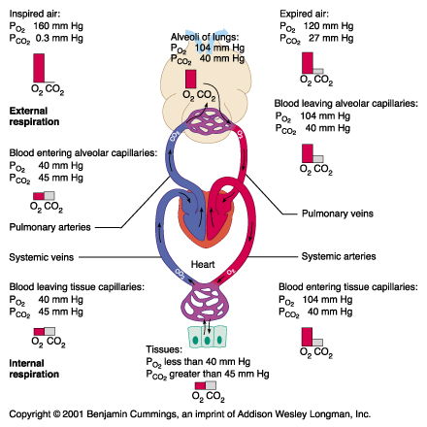
Partial Pressure Gradients
Figure 21.17

Slide 38
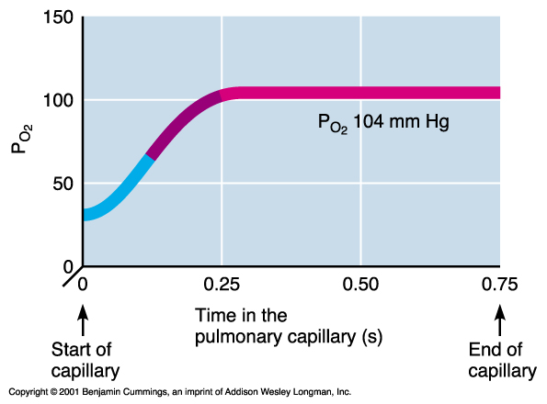
Oxygenation of Blood
Figure 21.18

Slide 39
Surface Area and Thickness of the Respiratory Membrane
Respiratory membranes:
  Are only 0.5 to 1 μm thick, allowing for efficient gas exchange
  Have a total surface area (in males) of 50–70 m² (40 times that of one’s skin)
  Thicken if lungs become waterlogged and edematous, whereby gas exchange is inadequate and oxygen deprivation results
  Decrease in surface area with emphysema, when walls of adjacent alveoli break

Slide 40
Internal Respiration
The factors promoting gas exchange between systemic capillaries and tissue cells are the same as those acting in the lungs
  The partial pressures and diffusion gradients are reversed
  P_{O2} in tissue is always lower than in systemic arterial blood
  P_{O2} of venous blood draining tissues is 40 mm Hg and P_{CO2} is 45 mm Hg

Slide 41
Oxygen Transport
Molecular oxygen is carried in the blood bound to hemoglobin (Hb) within red blood cells and dissolved in plasma
  Each hemoglobin molecule binds 4 oxygen in a rapid and reversible process
  The hemoglobin-oxygen combination is called oxyhemoglobin (HbO₂)
Hemoglobin that has
released oxygen is
called reduced
hemoglobin (HHb)
Lungs
HHb + O₂ ↔ HbO₂ + H⁺
Tissues

Slide 42
Hemoglobin (Hb)
Saturated hemoglobin – when all four hemes of the molecule are bound to oxygen
Partially saturated hemoglobin – when one to three hemes are bound to oxygen
The rate in which hemoglobin binds and releases oxygen is regulated by:
  P_{O2}, temperature, blood pH, P_{CO2}, and the concentration of BPG (an organic chemical)
    These factors ensure adequate delivery of oxygen to tissue cells

Slide 43
Influence of P_{O2} on Hemoglobin Saturation
Hemoglobin saturation plotted against P_{O2} produces a oxygen-hemoglobin dissociation curve
98% saturated arterial blood contains 20 ml oxygen per 100 ml blood (20 vol %)
As arterial blood flows through capillaries, 5 ml oxygen are released
The saturation of hemoglobin in arterial blood explains why breathing deeply increases the P_{O2} but has little effect on oxygen saturation in hemoglobin

Slide 44
Hemoglobin Saturation Curve
Hemoglobin is almost completely saturated at a P_{O2} of 70 mm Hg
Further increases in P_{O2} produce only small increases in oxygen binding
Oxygen loading and delivery to tissue is adequate when P_{O2} is below normal levels
Only 20–25% of bound oxygen is unloaded during one systemic circulation
If oxygen levels in tissues drop:
  More oxygen dissociates from hemoglobin and is used by cells
  Respiratory rate or cardiac output need not increase

Slide 45
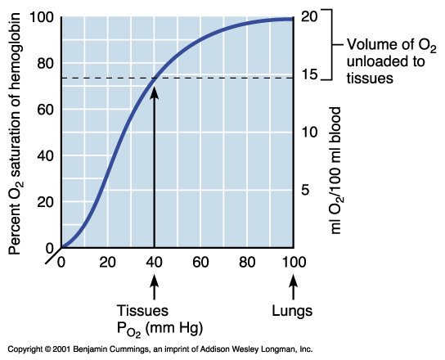
Hemoglobin Saturation Curve
Figure 21.20

Slide 46
Other Factors Influencing Hemoglobin Saturation
Temperature, H⁺, P_{CO2}, and BPG:
  Modify the structure of hemoglobin and alter its affinity for oxygen
  Increase:
    Decrease hemoglobin’s affinity for oxygen
    Enhance oxygen unloading from the blood
  Decrease act in the opposite manner
These parameters are all high in systemic capillaries where oxygen unloading is the goal

Slide 47
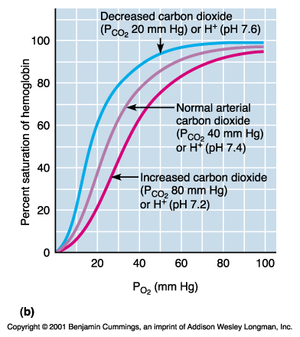
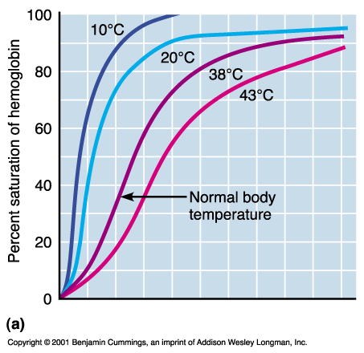
Other Factors Influencing Hemoglobin Saturation
Figure 21.21a, b

Slide 48
Factors That Increase Release of Oxygen by Hemoglobin
As cells metabolize glucose, carbon dioxide is released into the blood, causing:
  Increases in P_{CO2} and H⁺ concentration in capillary blood
  Declining pH (acidosis) weakens the hemoglobin-oxygen bond (Bohr effect)
Metabolizing cells have heat as a by-product and the rise in temperature increases BPG synthesis
All these factors ensure oxygen unloading in the vicinity of working tissue cells

Slide 49
Hemoglobin–Nitric Oxide Partnership
Nitric oxide (NO) is a vasodilator that plays a role in blood pressure regulation
Hemoglobin is a vasoconstrictor and a nitric oxide scavenger (heme destroys NO)
However, as oxygen bind to hemoglobin:
  Nitric oxide binds to a cysteine amino acid on hemoglobin
  Bound nitric oxide is protected from degradation by hemoglobin’s iron

Slide 50
Hemoglobin–Nitric Oxide Partnership
The hemoglobin is released as oxygen is unloaded, causing vasodilation
As deoxygenated hemoglobin picks up carbon dioxide, it also binds nitric oxide and carries these gases to the lungs for unloading

Slide 51
Carbon Dioxide Transport
Carbon dioxide is transported in the blood in three forms
  Dissolved in plasma – 7 to 10%
  Chemically bound to hemoglobin – 20% is carried in red blood cells as carbaminohemoglobin
  Bicarbonate ion in plasma – 70% is transported as bicarbonate (HCO₃–)

Slide 52
Transport and Exchange of Carbon Dioxide
Carbon dioxide diffuses into red blood cells and combines with water to form carbonic acid (H₂CO₃), which quickly dissociates into hydrogen ions and bicarbonate ions
In red blood cells, carbonic anhydrase reversibly catalyzes the conversion of carbon dioxide and water to carbonic acid
CO₂ | + | H₂O | ↔ | H₂CO₃ | ↔ | H⁺ | + | HCO₃–
Carbon dioxide |  | Water |  | Carbonic acid |  | Hydrogen ion |  | Bicarbonate ion

Slide 53
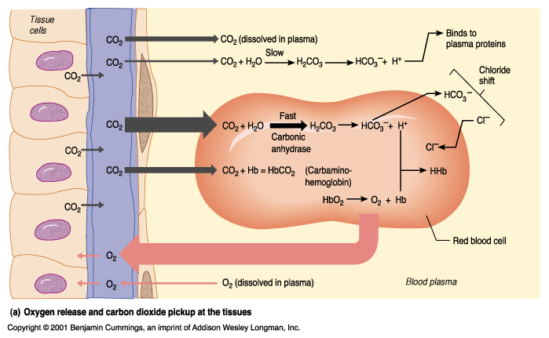
Transport and Exchange of Carbon Dioxide
Figure 21.22a

Slide 54
Transport and Exchange of Carbon Dioxide
At the tissues
  Bicarbonate quickly diffuses from red blood cells into the plasma
  Chloride shift – to counterbalance the outrush of negative bicarbonate ions from the red blood cells, chloride ions (Cl–) move from the plasma into the erythrocytes

Slide 55
Transport and Exchange of Carbon Dioxide
At the lungs, these processes are reversed
  Bicarbonate ions move into the red blood cells and bind with hydrogen ions to form carbonic acid
  Carbonic acid is then split by carbonic anhydrase to release carbon dioxide and water
  Carbon dioxide then diffuses from the blood into the alveoli

Slide 56
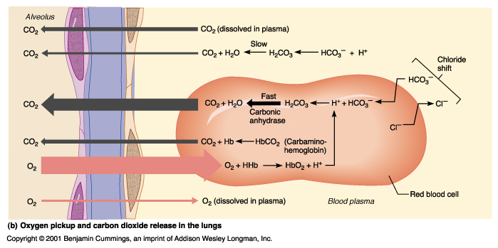
Transport and Exchange of Carbon Dioxide
Figure 21.22b

Slide 57
Influence of Carbon Dioxide on Blood pH
The carbonic acid–bicarbonate buffer system resists blood pH changes
If hydrogen ion concentration in blood begins to rise, it is removed by combining with HCO₃–
If hydrogen ion concentrations begin to drop, carbonic acid dissociates, releasing H⁺
Changes in respiratory rate can also:
  Alter blood pH
  Provide a fast-acting system to adjust pH when it is disturbed by metabolic factors

Slide 58
Control of Respiration:
Medullary Respiratory Centers
The dorsal respiratory group (DRG), or inspiratory center:
  Is located near the root of nerve IX
  Appears to be the pacesetting respiratory center
  Excites the inspiratory muscles and sets eupnea (12-15 breaths/minute)
  Becomes dormant during expiration
The ventral respiratory group (VRG) is involved in forced inspiration and expiration

Slide 59
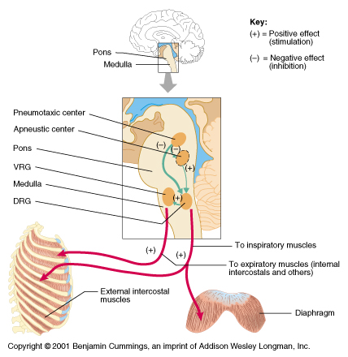
Control of Respiration:
Medullary Respiratory Centers
Figure 21.24

Slide 60
Control of Respiration: Pons Respiratory Centers
Pons centers
  Influence and modify activity of the medullary centers
  Smooth out inspiration and expiration transitions and vice versa
Pneumotaxic center – continuously inhibits the inspiration center
Apneustic center – continuously stimulates the medullary inspiration center

Slide 61
Respiratory Adjustments: Exercise
Respiratory adjustments are geared to both the intensity and duration of exercise
During vigorous exercise:
  Ventilation can increase 20 fold
  Breathing becomes deeper and more vigorous, but respiratory rate may not be significantly changed (hyperpnea)
Exercise-enhanced breathing is not prompted by an increase in P_{CO2} nor a decrease in P_{O2} or pH
  These levels remain surprisingly constant during exercise

Slide 62
Respiratory Adjustments: Exercise
As exercise begins:
  Ventilation increases abruptly, rises slowly, and reaches a steady state
When exercise stops:
  Ventilation declines suddenly, then gradually decreases to normal
Neural factors bring about the above changes, including:
  Psychic stimuli
  Cortical motor activation
  Excitatory impulses from proprioceptors in muscles

Slide 63
Respiratory Adjustments: High Altitude
The body responds to quick movement to high altitude (above 8000 ft) with symptoms of acute mountain sickness – headache, shortness of breath, nausea, and dizziness
Acclimatization – respiratory and hematopoietic adjustments to altitude include
  Increased ventilation – 2–3 L/min higher than at sea level
  Chemoreceptors become more responsive to P_{CO2}
  Substantial decline in P_{O2} stimulates peripheral chemoreceptors

Slide 64
Chronic Obstructive Pulmonary Disease (COPD)
Exemplified by chronic bronchitis and obstructive emphysema
Patients have a history of:
  Smoking
  Dyspnea, where labored breathing occurs and gets progressively worse
  Coughing and frequent pulmonary infections
COPD victims develop respiratory failure accompanied by hypoxemia, carbon dioxide retention, and respiratory acidosis

Slide 65
Asthma
Characterized by dyspnea, wheezing, and chest tightness
Active inflammation of the airways precedes bronchospasms
Airway inflammation is an immune response caused by release of IL-4 and IL-5, which stimulate IgE and recruit inflammatory cells
Airways thickened with inflammatory exudates magnify the effect of bronchospasms

Slide 66
Tuberculosis
Infectious disease caused by the bacterium Mycobacterium tuberculosis
Symptoms include fever, night sweats, weight loss, a racking cough, and spitting up blood
Treatment entails a 12-month course of antibiotics

Slide 67
Lung Cancer
Accounts for 1/3 of all cancer deaths in the US
90% of all patients with lung cancer were smokers
The three most common types are:
  Squamous cell carcinoma (20–40% of cases) arises in bronchial epithelium
  Adenocarcinoma (25–35% of cases) originates in peripheral lung area
  Small cell carcinoma (20–25% of cases) contains lymphocyte-like cells that originate in the primary bronchi and subsequently metastasize

