Slide 1
CARDIOVASCULAR, LYMPHATIC AND IMMUNE SYSTEMS

Slide 2
INTRODUCTION
Blood leaves the heart via arteries that branch repeatedly until they become capillaries
Oxygen (O₂) and nutrients diffuse across capillary walls and enter tissues
Carbon dioxide (CO₂) and wastes move from tissues into the blood
Oxygen-deficient blood leaves the capillaries and flows in veins to the heart
This blood flows to the lungs where it releases CO₂ and picks up O₂
The oxygen-rich blood returns to the heart

Slide 3
BLOOD
Part A

Slide 4
Composition of Blood
Blood is the body’s only fluid tissue
It is composed of liquid plasma and formed elements
Formed elements include:
  Erythrocytes, or red blood cells (RBCs)
  Leukocytes, or white blood cells (WBCs)
  Platelets
Hematocrit – the percentage of RBCs out of the total blood volume

Slide 5
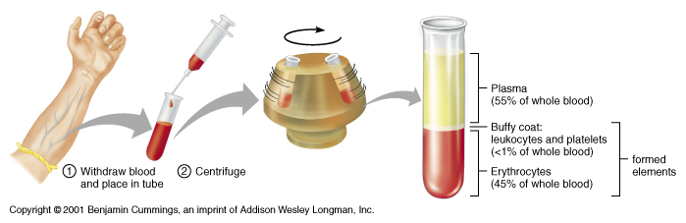
Composition of Blood

Slide 6
Physical Characteristics and Volume
Blood is a sticky, opaque fluid with a metallic taste
Color varies from scarlet (oxygen-rich) to dark red (oxygen-poor)
The pH of blood is 7.35–7.45
Temperature is 38°C, slightly higher than “normal” body temperature
Blood accounts for approximately 8% of body weight
Average volume of blood is 5–6 L for males, and 4–5 L for females

Slide 7
Functions of Blood
Blood performs a number of functions dealing with:
  Substance distribution
  Regulation of blood levels of particular substances
  Body protection

Slide 8
Distribution
Blood transports:
  Oxygen from the lungs and nutrients from the digestive tract
  Metabolic wastes from cells to the lungs and kidneys for elimination
  Hormones from endocrine glands to target organs

Slide 9
Regulation
Blood maintains:
  Appropriate body temperature by absorbing and distributing heat
  Normal pH in body tissues using buffer systems
  Adequate fluid volume in the circulatory system

Slide 10
Protection
Blood prevents blood loss by:
  Activating plasma proteins and platelets
  Initiating clot formation when a vessel is broken
Blood prevents infection by:
  Synthesizing and utilizing antibodies
  Activating complement proteins
  Activating WBCs to defend the body against foreign invaders

Slide 11
Blood Plasma
Blood plasma contains over 100 solutes, including:
  Proteins – albumin, globulins, clotting proteins, and others
  Nonprotein nitrogenous substances – lactic acid, urea, creatinine
  Organic nutrients – glucose, carbohydrates, amino acids
  Electrolytes – sodium, potassium, calcium, chloride, bicarbonate
  Respiratory gases – oxygen and carbon dioxide

Slide 12
Blood Cells
Erythrocytes, leukocytes, and platelets make up the formed elements
  Only WBCs are complete cells
  RBCs have no nuclei or organelles, and platelets are just cell fragments
Most formed elements survive in the bloodstream for only a few days
Most blood cells do not divide but are renewed by cells in bone marrow

Slide 13
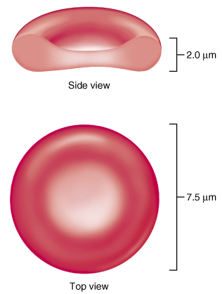
Erythrocytes (RBCs)
Biconcave discs, anucleate, essentially no organelles
Filled with hemoglobin (Hb), a protein that functions in gas transport
Contain the plasma membrane protein spectrin that:
  Gives erythrocytes their flexibility
  Allows them to change shape as necessary
Figure 16.3

Slide 14
Erythrocyte Function
Erythrocytes are dedicated to respiratory gas transport
Hemoglobin reversibly binds with oxygen and most oxygen in the blood is bound to hemoglobin
Hemoglobin is composed of:
  The protein globin, made up of two alpha and two beta chains, each bound to a heme group
  Each heme group bears an atom of iron, which can bind one to oxygen molecule
Each hemoglobin molecule can transport four molecules of oxygen

Slide 15
Hemoglobin (Hb)
Oxyhemoglobin – hemoglobin bound to oxygen
  Oxygen loading takes place in the lungs
Deoxyhemoglobin – hemoglobin after oxygen diffuses into tissues (reduced Hb)
Carbaminohemoglobin – hemoglobin bound to carbon dioxide
  Carbon dioxide loading takes place in the tissues

Slide 16
Erythrocyte Disorders
Anemia – blood has abnormally low oxygen-carrying capacity
  It is a symptom rather than a disease itself
  Blood oxygen levels cannot support normal metabolism
  Signs/symptoms include fatigue, paleness, shortness of breath, and chills

Slide 17
Anemia: Insufficient Erythrocytes
Hemorrhagic anemia – result of acute or chronic loss of blood
Hemolytic anemia – prematurely ruptured erythrocytes
Aplastic anemia – destruction or inhibition of red bone marrow

Slide 18
Anemia: Decreased Hemoglobin Content
Iron-deficiency anemia results from:
  A secondary result of hemorrhagic anemia
  Inadequate intake of iron-containing foods
  Impaired iron absorption
Pernicious anemia results from:
  Deficiency of vitamin B₁₂
  Often caused by lack of intrinsic factor needed for absorption of B₁₂

Slide 19
Anemia: Abnormal Hemoglobin
Thalassemias – absent or faulty globin chain in hemoglobin
  Erythrocytes are thin, delicate, and deficient in hemoglobin
Sickle-cell anemia – results from a defective gene coding for an abnormal hemoglobin called hemoglobin S (HbS)
  HbS has a single amino acid substitution in the beta chain
  This defect causes RBCs to become sickle-shaped in low-oxygen situations

Slide 20
Polycythemia
Polycythemia – excess RBCs that increase blood viscosity
Three main polycythemias are:
  Polycythemia vera
  Secondary polycythemia
  Blood doping

Slide 21
Leukocytes (WBCs)
Leukocytes, the only blood components that are complete cells:
  Are less numerous than RBCs
  Make up 1% of the total blood volume
  Can leave capillaries via diapedesis
  Move through tissue spaces
Leukocytosis – WBC count over 11,000 per cubic millimeter
  Normal response to bacterial or viral invasion

Slide 22
Classification of Leukocytes: Granulocytes
Granulocytes – neutrophils, eosinophils, and basophils
  Contain cytoplasmic granules that stain specifically (acidic, basic, or both) with Wright’s stain
  Are larger and usually shorter lived than RBCs
  Have lobed nuclei
  Are all phagocytic cells

Slide 23
Neutrophils
Neutrophils have two types of granules that:
  Take up both acidic and basic dyes
  Give the cytoplasm a lilac color
  Contain peroxidases, hydrolytic enzymes, and defensins (antibiotic-like proteins)
Neutrophils are our body’s bacterial slayers

Slide 24
Eosinophils
Eosinophils account for 1–4% of WBCs
  Have red-staining, bi-lobed nuclei connected via a broad band of nuclear material
  Have red to crimson (acidophilic) large, coarse, lysosome-like granules
  Lead the body’s counterattack against parasitic worms
  Lessen the severity of allergies by phagocytizing immune complexes

Slide 25
Basophils
Account for 0.5% of WBCs and:
  Have U- or S-shaped nuclei with two or three conspicuous constrictions
  Are functionally similar to mast cells
  Have large, purplish-black (basophilic) granules that contain histamine
    Histamine – inflammatory chemical that acts as a vasodilator and attracts other WBCs

Slide 26
Agranulocytes
Agranulocytes – lymphocytes and monocytes:
  Lack visible cytoplasmic granules
  Are similar structurally, but are functionally distinct and unrelated cell types
  Have spherical (lymphocytes) or kidney-shaped (monocytes) nuclei

Slide 27
Lymphocytes
Have large, dark-purple, circular nuclei with a thin rim of blue cytoplasm
Found mostly enmeshed in lymphoid tissue (some circulate in the blood)
There are two types of lymphocytes: T cells and B cells
  T cells function in the immune response
  B cells give rise to plasma cells, which produce antibodies

Slide 28
Monocytes
Monocytes account for 4–8% of leukocytes
  They are the largest leukocytes
  They have abundant pale-blue cytoplasms
  They have purple staining, U- or kidney-shaped nuclei
  They leave the circulation, enter tissue, and differentiate into macrophages
Macrophages:
  Are highly mobile and actively phagocytic
  Activate lymphocytes to mount an immune response

Slide 29
Leukocyte Disorders: Leukemias
Leukemia refer to cancerous conditions involving white blood cells
Leukemias are named according to the abnormal white blood cells involved
  Myelocytic leukemia – involves myeloblasts
  Lymphocytic leukemia – involves lymphocytes
Acute leukemia involves blast-type cells and primarily affects children
Chronic leukemia is more prevalent in older people

Slide 30
Leukemia
Immature white blood cells are found in the bloodstream in all leukemias
Bone marrow becomes totally occupied with cancerous leukocytes
The white blood cells produced, though numerous, are not functional
Death is caused by internal hemorrhage and overwhelming infections
Treatments include irradiation, antileukemic drugs, and bone marrow transplants

Slide 31
Platelets
Platelets are fragments of megakaryocytes with a blue-staining outer region and a purple granular center
The granules contain serotonin, Ca²⁺, enzymes, ADP, and platelet-derived growth factor (PDGF)
Platelets function in the clotting mechanism by forming a temporary plug that helps seal breaks in blood vessels

Slide 32
Hemostasis
A series of reactions designed for stoppage of bleeding
During hemostasis, three phases occur in rapid sequence
  Vascular spasms – immediate vasoconstriction in response to injury
  Platelet plug formation
  Coagulation (blood clotting)

Slide 33
Platelet Plug Formation
Platelets do not stick to each other or to the endothelial lining of blood vessels
Upon damage to a blood vessel, platelets:
  Are stimulated by thromboxane A₂
  Stick to exposed collagen fibers and form a platelet plug
  Release serotonin and ADP, which attract still more platelets
The platelet plug is limited to the immediate area of injury by PGI₂

Slide 34
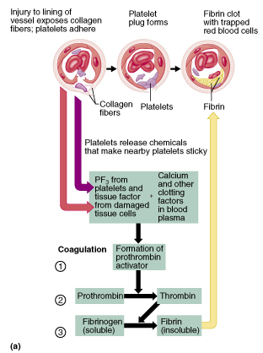
Coagulation
A set of reactions in which blood is transformed from a liquid to a gel
Coagulation follows intrinsic and extrinsic pathways
Figure 16.13a

Slide 35
Coagulation
The final thee steps of this series of reactions are:
  Prothrombin activator is formed
  Prothrombin is converted into thrombin
  Thrombin catalyzes the joining of fibrinogen into a fibrin mesh
Figure 16.13a

Slide 36
Hemostasis Disorders: Bleeding Disorders
Thrombocytopenia – condition where the number of circulating platelets is deficient
  Patients show petechiae (small purple blotches on the skin) due to spontaneous, widespread hemorrhage
  Caused by suppression or destruction of bone marrow (e.g., malignancy, radiation)
  Platelet counts less than 50,000/mm³ is diagnostic for this condition
  Treated with whole blood transfusions

Slide 37
Hemostasis Disorders: Bleeding Disorders
Inability to synthesize procoagulants by the liver results in severe bleeding disorders
Causes can range from vitamin K deficiency to hepatitis and cirrhosis
Inability to absorb fat can lead to vitamin K deficiencies as it is a fat-soluble substance and is absorbed along with fat
Liver disease can also prevent the liver from producing bile, which is required for fat and vitamin K absorption

Slide 38
Hemostasis Disorders: Bleeding Disorders
Hemophilias – hereditary bleeding disorders caused by lack of clotting factors
  Hemophilia A – most common type (83% of all cases) due to a deficiency of factor VIII
  Hemophilia B – results from a deficiency of factor IX
  Hemophilia C – mild type, caused by a deficiency of factor XI
Symptoms include prolonged bleeding and painful and disabled joints
Treatment is with blood transfusions and the injection of missing factors

Slide 39
Blood Transfusions
Transfusions are necessary:
  When substantial blood loss occurs
  In certain hemostatis disorders
Whole blood transfusions are used:
  When blood loss is substantial
  In treating thrombocytopenia
Packed red cells (cells with plasma removed) are used to treat anemia

Slide 40
Human Blood Groups
RBC membranes have glycoprotein antigens on their external surfaces
These antigens are:
  Unique to the individual
  Recognized as foreign if transfused into another individual
  Promoters of agglutination and are referred to as agglutinogens
Presence/absence of these antigens are used to classify blood groups

Slide 41
Blood Groups
Humans have 30 varieties of naturally occurring RBC antigens
The antigens of the ABO and Rh blood groups cause vigorous transfusion reactions when they are improperly transfused
Other blood groups (M, N, Dufy, Kell, and Lewis) are mainly used for legalities

Slide 42
ABO Blood Groups
The ABO blood groups consists of:
  Two antigens (A and B) on the surface of the RBCs
  Two antibodies in the plasma (anti-A and anti-B)
An individual with ABO blood may have various types of antigens and spontaneously preformed antibodies
Agglutinogens and their corresponding antibodies cannot be mixed without serious hemolytic reactions

Slide 43
Rh Blood Groups
There are eight different Rh agglutinogens, three of which (C, D, and E) are common
Presence of the Rh agglutinogens on RBCs is indicated as Rh⁺
Anti-Rh antibodies are not spontaneously formed in Rh– individuals
However, if an Rh– individual receives Rh⁺ blood, anti-Rh antibodies form
A second expose to Rh⁺ blood will result in a typical transfusion reaction

Slide 44
Hemolytic Disease of the Newborn
Hemolytic disease of the newborn – Rh⁺ antibodies of a sensitized Rh– mother cross the placenta and attack and destroy the RBCs of an Rh⁺ baby
Rh– mother become sensitized when Rh⁺ blood (from a previous pregnancy of an Rh⁺ baby or a Rh⁺ transfusion) causes her body to synthesis Rh⁺ antibodies
The drug RhoGAM can prevent the Rh– mother from becoming sensitized
Treatment of hemolytic disease of the newborn involves pre-birth transfusions and exchange transfusions after birth

Slide 45
Transfusion Reactions
Transfusion reactions occur when mismatched blood is infused
Donor’s cells are attacked by the recipient’s plasma agglutinins causing:
  Diminished oxygen-carrying capacity
  Clumped cells that impede blood flow
  Ruptured RBCs that release free hemoglobin into the bloodstream
Circulating hemoglobin precipitates in the kidneys and causes renal failure

Slide 46
Blood Typing
When serum containing anti-A or anti-B agglutinins is added to blood, agglutination will occur between the agglutinin and the corresponding agglutinogens
Positive reactions indicate agglutination

Slide 47
Plasma Volume Expanders
When shock is imminent from low blood volume, volume must be replaced
Plasma or plasma expanders can be administered
Plasma expanders:
  Have osmotic properties that directly increase fluid volume
  Are used when plasma is not available
  Examples: purified human serum albumin, plasminate and dextran
Isotonic saline can also be used to replace lost blood volume

Slide 48
Diagnostic Blood Tests
Laboratory examination of blood can assess an individual’s state of health
Microscopic examination:
  Variations in size and shape of RBCs – predictions of anemias
  Type and number of WBCs – diagnostic of various diseases
Chemical analysis can provide a comprehensive picture of one’s general health status in relation to normal values

Slide 49
HEART
The Cardiovascular System: The Heart
Part B

Slide 50
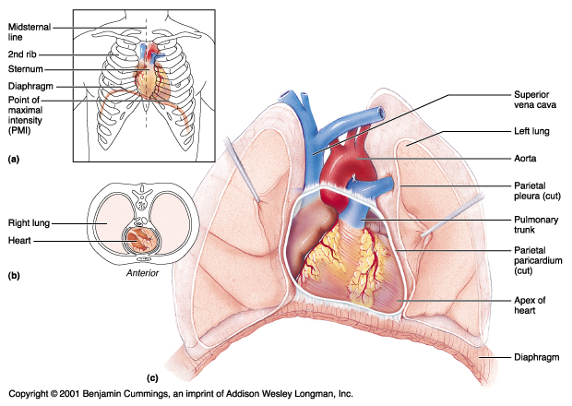
Heart Location
Approximately the size of your fist
Location
  Superior surface of diaphragm
  Left of the midline
  Anterior to the vertebral column, posterior to the sternum

Slide 51
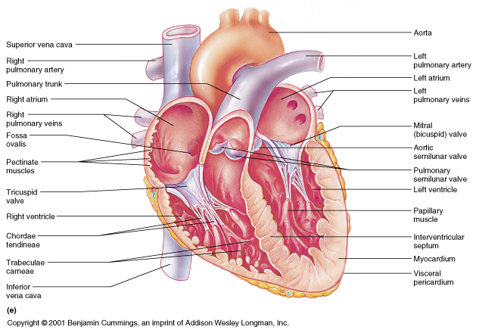
Cross Section of the of Heart
Frontal section showing interior chambers and valves
Major vessels leading to and from the heart

Slide 52
Atria of the Heart
Atria are the receiving chambers of the heart
Each atrium has a protruding auricle
Pectinate muscles mark atrial walls
Blood enters right atria from superior and inferior venae cavae and coronary sinus
Blood enters left atria from pulmonary veins

Slide 53
Ventricles of the Heart
Ventricles are the discharging chambers of the heart
Papillary muscles and trabeculae carneae muscles mark ventricular walls
Right ventricle pumps blood into the pulmonary trunk
Left ventricle pumps blood into the aorta

Slide 54
Pathway of Blood through the Heart and Lungs
Right atrium → tricuspid valve → right ventricle
Right ventricle → pulmonary semilunar valve → pulmonary arteries → lungs
Lungs → pulmonary veins → left atrium
Left atrium → bicuspid valve → left ventricle
Left ventricle → aortic semilunar valve → aorta
Aorta → systemic circulation

Slide 55
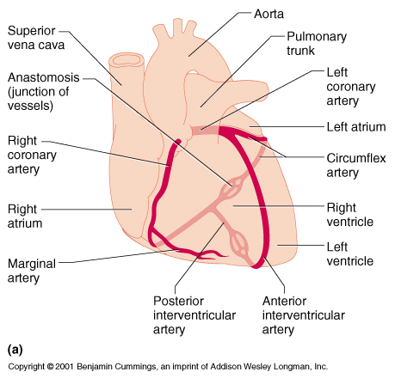
Coronary Circulation
Coronary circulation is the functional blood supply to the heart
Collateral routes insure blood delivery to heart even if major vessels are occluded

Slide 56
Heart Valves
Heart valves insure unidirectional blood flow through the heart
Atrioventricular (AV) valves lie between the atria and the ventricles
AV valves prevent backflow into the atria when ventricles contract
Chordae tendineae anchor AV valves to papillary muscles
Aortic semilunar valve lies between the left ventricle and the aorta
Pulmonary semilunar valve lies between the right ventricle and pulmonary trunk
Semilunar valves prevent backflow of blood into the ventricles

Slide 57
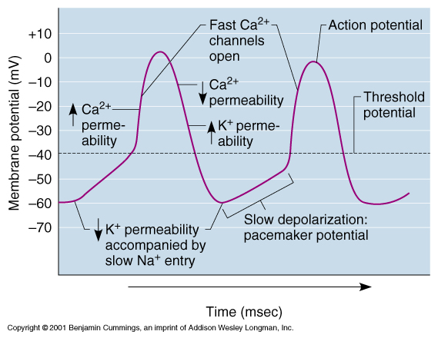
Intrinsic Conduction System
Autorhythmic cells:
  Initiate action potentials
  Have unstable resting potentials called pacemaker potentials
  Use calcium influx (rather than sodium) for rising phase of the action potential

Slide 58
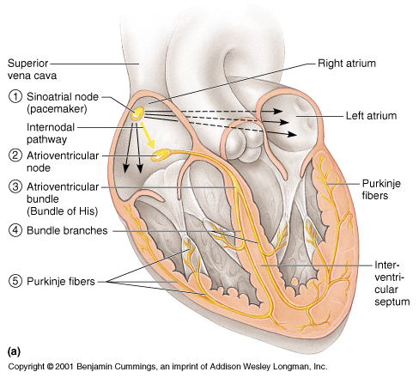
Sequence of Excitation
Sinoatrial (SA) node generates impulses about 75 times/minute
Atrioventricular (AV) node delays the impulse approximately 0.1 second
Impulse passes from atria to ventricles via the atrioventricular bundle (bundle of His)

Slide 59
Sequence of Excitation
AV bundle splits into two pathways in the interventricular septum (bundle branches)
  Bundle branches carry the impulse toward the apex of the heart
  Purkinje fibers carry the impulse to the heart apex and ventricular walls

Slide 60
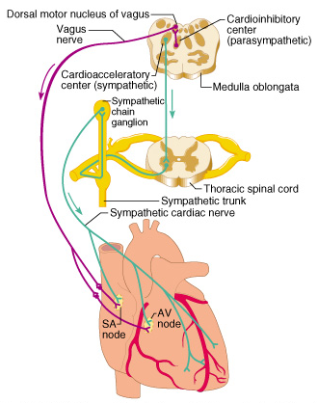
Extrinsic Innervation of the Heart
The heart is stimulated by the sympathetic cardioacceleratory center
The heart is inhibited by the parasympathetic cardioinhibitory center
Figure 17.15

Slide 61
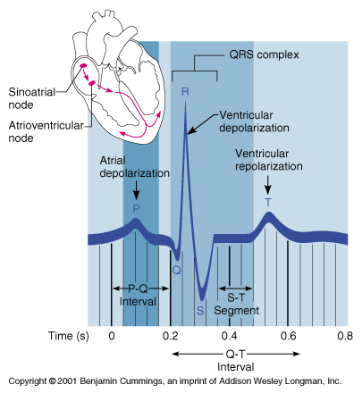
Electrocardiography (ECG)
Electrical activity is recorded by electrocardiogram (ECG)
P wave corresponds to depolarization of SA node
QRS complex corresponds to ventricular depolarization
T wave corresponds to ventricular repolarization
Atrial repolarization record is masked by the larger QRS complex

Slide 62
Cardiac Cycle
Cardiac cycle refers to all events associated with blood flow through the heart
  Systole – contraction of heart muscle
  Diastole – relaxation of heart muscle

Slide 63
Phases of the Cardiac Cycle
Ventricular filling – mid-to-late diastole
  Heart blood pressure is low as blood enters atria and flows into ventricles
  AV valves are open, then atrial systole occurs
Ventricular systole
  Atria relax
  Rising ventricular pressure results in closing of AV valves
  Isovolumetric contraction phase
  Ventricular ejection phase opens semilunar valves

Slide 64
Phases of the Cardiac Cycle
Isovolumetric relaxation – early diastole
  Ventricles relax
  Backflow of blood in aorta and pulmonary trunk closes semilunar valves
Dicrotic notch – brief rise in aortic pressure caused by backflow of blood rebounding off semilunar valves

Slide 65
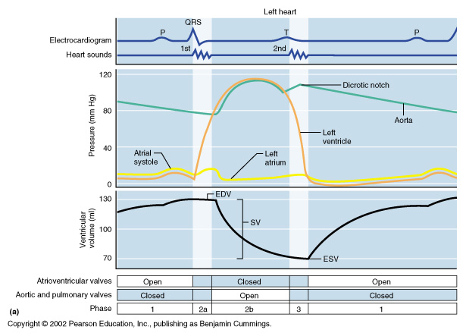
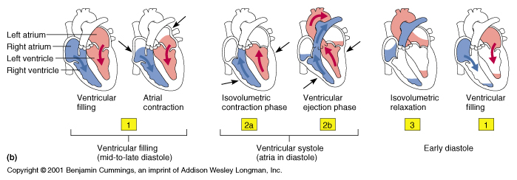
Phases of the Cardiac Cycle

Slide 66
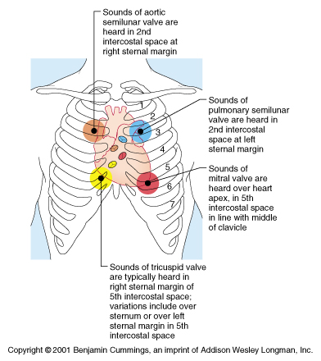
Heart Sounds
Heart sounds
(lub-dup) are associated with closing of heart valves

Slide 67
Cardiac Output (CO) and Reserve
CO is the amount of blood pumped by each ventricle in one minute
CO is the product of heart rate (HR) and stroke volume (SV)
HR is the number of heart beats per minute
SV is the amount of blood pumped out by a ventricle with each beat
Cardiac reserve is the difference between resting and maximal CO
Example
CO (ml/min) = HR (75 beats/min) x SV (70 ml/beat)
CO = 5250 ml/min (5.25 L/min)

Slide 68
Regulation of Stroke Volume
SV = end diastolic volume (EDV) minus end systolic volume (ESV)
EDV = amount of blood collected in a ventricle during diastole
ESV = amount of blood remaining in a ventricle after contraction

Slide 69
Factors Affecting Stroke Volume
Preload – amount ventricles are stretched by contained blood
Contractility – cardiac cell contractile force due to factors other than EDV
Afterload – back pressure exerted by blood in the large arteries leaving the heart

Slide 70
Extrinsic Factors Influencing Stroke Volume
Contractility is the increase in contractile strength, independent of stretch and EDV
Increase in contractility comes from:
  Increased sympathetic stimuli
  Certain hormones
  Ca²⁺ and some drugs
Agents/factors that decrease contractility include:
  Acidosis
  Increased extracellular potassium
  Calcium channel blockers

Slide 71
Regulation of Heart Rate: Autonomic Nervous System
Sympathetic nervous system (SNS) stimulation is activated by stress, anxiety, excitement, or exercise
Parasympathetic nervous system (PNS) stimulation is mediated by acetylcholine and opposes the SNS
PNS dominates the autonomic stimulation, slowing heart rate and causing vagal tone

Slide 72
Bainbridge Reflex
Bainbridge (atrial) reflex – a sympathetic reflex initiated by increased blood in the atria
  Causes stimulation of the SA node
  Stimulates baroreceptors in the atria, causing increased SNS stimulation

Slide 73
Chemical Regulation of the Heart
The hormones epinephrine and thyroxine increase heart rate
Intra- and extracellular ion concentrations must be maintained for normal heart function

Slide 74
Homeostatic Imbalances
Hypocalcemia – reduced ionic calcium depresses the heart
Hypercalcemia – dramatically increases heart irritability and leads to spastic contractions
Hypernatremia – blocks heart contraction by inhibiting ionic calcium transport
Hyperkalemia – leads to heart block and cardiac arrest
Tachycardia – heart rate over 100 beats/min
Bradycardia – heart rate less than 60 beats/min

Slide 75
Congestive Heart Failure (CHF)
Congestive heart failure (CHF), caused by:
  Coronary atherosclerosis
  Increased blood pressure in aorta
  Successive myocardial infarcts
  Dilated cardiomyopathy (DCM)

Slide 76
BLOOD VESSELS
The Cardiovascular System: Blood Vessels
Part C

Slide 77
Blood Vessels
Blood is carried in a closed system of vessels that begins and ends at the heart
The three major types of vessels are arteries, capillaries, and veins
  Arteries carry blood away from the heart, veins carry blood toward the heart
  Capillaries contact tissue cells and directly serve cellular needs

Slide 78
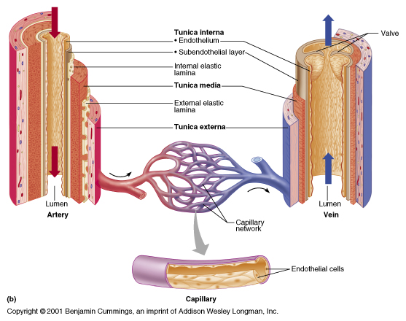
Generalized Structure of Blood Vessels
Arteries and veins are composed of three tunics – tunica interna, tunica media, and tunica externa
Capillaries are composed of endothelium with sparse basal lamina
Lumen – central blood-containing space surrounded by tunics

Slide 79
Tunics
Tunica interna (tunica intima)
  Endothelial layer that lines the lumen of all vessels
  In vessels larger than 1 mm, a subendothelial connective tissue basement membrane is present
Tunica media
  Smooth muscle and elastic fiber layer, regulated by the sympathetic nervous system
  Controls vasoconstriction/vasodilation of vessels
Tunica externa (tunica adventitia)
  Collagen fibers that protect and reinforce vessels
  Larger vessels contain vasa vasorum

Slide 80
Elastic (Conducting) Arteries
Thick-walled arteries near the heart; the aorta and its major branches
  Large lumen allow low-resistance conduction of blood
  Contain elastin in all three tunics
  Withstand and smooth out large blood pressure fluctuations
  Allow blood to flow fairly continuously through the body

Slide 81
Muscular Arteries and Arterioles
Muscular arteries – distal to elastic arteries; deliver blood to body organs
  Have thick tunica media with more smooth muscle and less elastic tissue
  Active in vasoconstriction
Arterioles – smallest arteries; lead to capillary beds
  Control flow into capillary beds via vasodilation and constriction

Slide 82
Capillaries
Capillaries are the smallest blood vessels
  Walls consisting of a thin tunica interna, one cell thick
  Allow only a single RBC to pass at a time
  Pericytes on the outer surface stabilize their walls
There are three structural types of capillaries: continuous, fenestrated, and sinusoids

Slide 83
Continuous Capillaries
Continuous capillaries are abundant in the skin and muscles, and have:
  Endothelial cells that provide an uninterrupted lining
  Adjacent cells that are held together with tight junctions
  Intercellular clefts of unjoined membranes that allow the passage of fluids
Continuous capillaries of the brain:
  Have tight junctions completely around the endothelium
  Constitute the blood-brain barrier

Slide 84
Fenestrated Capillaries
Found wherever active capillary absorption or filtrate formation occurs (e.g., small intestines, endocrine glands, and kidneys)
Characterized by:
  An endothelium riddled with pores (fenestrations)
  Greater permeability to solutes and fluids than other capillaries

Slide 85
Sinusoids
Highly modified, leaky, fenestrated capillaries with large lumens
Found in the liver, bone marrow, lymphoid tissue, and in some endocrine organs
Allow large molecules (proteins and blood cells) to pass between the blood and surrounding tissues
Blood flows sluggishly, allowing for modification in various ways

Slide 86
Capillary Beds
A microcirculation of interwoven networks of capillaries, consisting of:
  Vascular shunts – metarteriole–thoroughfare channel connecting an arteriole directly with a postcapillary venule
  True capillaries – 10 to 100 per capillary bed, capillaries branch off the metarteriole and return to the thoroughfare channel at the distal end of the bed

Slide 87
Blood Flow Through Capillary Beds
Precapillary sphincter
  Cuff of smooth muscle that surrounds each true capillary
  Regulates blood flow into the capillary
Blood flow is regulated by vasomotor nerves and local chemical conditions, so it can either bypass or flood the capillary bed

Slide 88
Venous System: Venules
Are formed when capillary beds unite
  Allow fluids and WBCs to pass from the bloodstream to tissues
Postcapillary venules – smallest venules, composed of endothelium and a few pericytes
Large venules have one or two layers of smooth muscle (tunica media)

Slide 89
Venous System: Veins
Veins are:
  Formed when venules converge
  Composed of three tunics, with a thin tunica media and a thick tunica externa consisting of collagen fibers and elastic networks
  Capacitance vessels (blood reservoirs) that contain 65% of the blood supply

Slide 90
Venous System: Veins
Veins have much lower blood pressure and thinner walls than arteries
To return blood to the heart, veins have special adaptations
  Large-diameter lumens, which offer little resistance to flow
  Valves (resembling semilunar heart valves), which prevent backflow of blood
Venous sinuses – specialized, flattened veins with extremely thin walls (e.g., coronary sinus of the heart and dural sinuses of the brain)

Slide 91
Vascular Anastomoses
Merging blood vessels, more common in veins than arteries
Arterial anastomoses provide alternate pathways (collateral channels) for blood to reach a given body region
  If one branch is blocked, the collateral channel can supply the area with adequate blood supply
Thoroughfare channels are examples of arteriovenous anastomoses

Slide 92
Blood Flow
Actual volume of blood flowing through a vessel, an organ, or the entire circulation in a given period is:
  Measured in ml per min
  Equivalent to cardiac output (CO), considering the entire vascular system
  Relatively constant when at rest
  Varies widely through individual organs, according to immediate needs

Slide 93
Blood Pressure (BP)
Force per unit area exerted on the wall of a blood vessel by its contained blood
  Expressed in terms of millimeters of mercury (mm Hg)
  Measured in reference to systemic arterial BP in large arteries near the heart
The differences in BP within the vascular system provide the driving force that keeps blood moving from higher to lower pressure areas

Slide 94
Resistance
Resistance – opposition to flow
  Measure of the amount of friction blood encounters as it passes through vessels
  Generally encountered in the systemic circulation
  Referred to as peripheral resistance (PR)
The three important sources of resistance are blood viscosity, total blood vessel length, and blood vessel diameter

Slide 95
Resistance Factors: Viscosity and Vessel Length
Resistance factors that remain relatively constant are:
  Blood viscosity – thickness or “stickiness” of the blood
  Blood vessel length – the longer the vessel, the greater the resistance encountered

Slide 96
Resistance Factors: Blood Vessel Diameter
Changes in vessel diameter are frequent and significantly alter peripheral resistance
Resistance varies inversely with the fourth power of vessel radius (one-half the diameter)
  For example, if the radius is doubled, the resistance is 1/16 as much
Small-diameter arterioles are the major determinants of peripheral resistance
Fatty plaques from atherosclerosis:
  Cause turbulent blood flow
  Dramatically increase resistance due to turbulence

Slide 97
Blood Flow, Blood Pressure, and Resistance
Blood flow (F) is directly proportional to the difference in blood pressure (ΔP) between two points in the circulation
  If ΔP increases, blood flow speeds up; if ΔP decreases, blood flow declines
Blood flow is inversely proportional to resistance (R)
  If R increases, blood flow decreases
R is more important than ΔP in influencing local blood pressure

Slide 98
Systemic Blood Pressure
The pumping action of the heart generates blood flow through the vessels along a pressure gradient, always moving from higher- to lower-pressure areas
Pressure results when flow is opposed by resistance
Systemic pressure:
  Is highest in the aorta
  Declines throughout the length of the pathway
  Is 0 mm Hg in the right atrium
The steepest change in blood pressure occurs in the arterioles

Slide 99
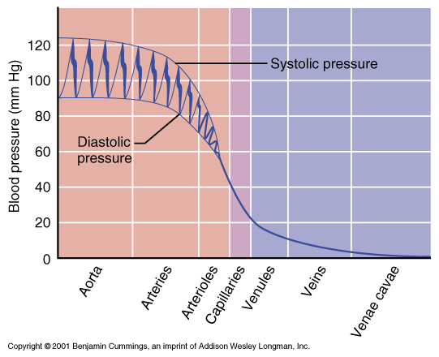
Systemic Blood Pressure
Figure 18.5

Slide 100
Arterial Blood Pressure
Arterial BP reflects two factors of the arteries close to the heart
  Their elasticity (compliance, or distensibility)
  The amount of blood forced into them at any given time
Blood pressure in elastic arteries near the heart is pulsatile (BP rises and falls)

Slide 101
Arterial Blood Pressure
Systolic pressure – pressure exerted on arterial walls during ventricular contraction
Diastolic pressure – lowest level of arterial pressure during a ventricular cycle
Pulse pressure – the difference between systolic and diastolic pressure
Mean arterial pressure (MAP) – pressure that propels the blood to the tissues
MAP = diastolic pressure + 1/3 pulse pressure

Slide 102
Capillary Blood Pressure
Capillary BP ranges from 20 to 40 mm Hg
Low capillary pressure is desirable because high BP would rupture fragile, thin-walled capillaries
Low BP is sufficient to force filtrate out into interstitial space and distribute nutrients, gases, and hormones between blood and tissues

Slide 103
Venous Blood Pressure
Venous BP is steady and changes little during the cardiac cycle
The pressure gradient in the venous system is only about 20 mm Hg
A cut vein has even blood flow; a lacerated artery flows in spurts

Slide 104
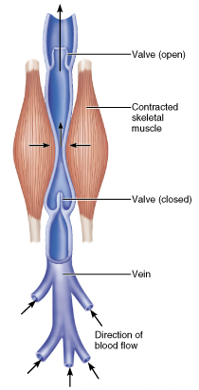
Factors Aiding Venous Return
Venous BP alone is too low to promote adequate blood return and is aided by the:
  Respiratory pump – pressure changes created during breathing suck blood toward the heart by squeezing local veins
  Muscular pump – contraction of skeletal muscles “milk” blood toward the heart
Valves prevent backflow during venous return
Figure 18.6

Slide 105
Blood Pressure
Maintaining blood pressure requires:
  Cooperation of the heart, blood vessels, and kidneys
  Supervision of the brain
The main factors influencing blood pressure are:
  Cardiac output (CO)
  Peripheral resistance (PR)
  Blood volume
Blood pressure = CO x PR
Blood pressure varies directly with CO, PR, and blood volume

Slide 106
Cardiac Output (CO)
Cardiac output is determined by venous return and neural and hormonal controls
Resting heart rate is controlled by the cardioinhibitory center via the vagus nerves
  Stroke volume is controlled by venous return (end diastolic volume, or EDV)
Under stress, the cardioacceleratory center increases heart rate and stroke volume
  The end systolic volume (ESV) decreases and MAP increases

Slide 107
Controls of Blood Pressure
Short-term controls:
  Are mediated by the nervous system and bloodborne chemicals
  Counteract moment-to-moment fluctuations in blood pressure by altering peripheral resistance
Long-term controls regulate blood volume

Slide 108
Short-Term Mechanisms: Neural Controls
Neural controls of peripheral resistance:
  Alter blood distribution to respond to specific demands
  Maintain MAP by altering blood vessel diameter
Neural controls operate via reflex arcs, involving:
  Baroreceptors
  Vasomotor centers of the medulla and vasomotor fibers
  Vascular smooth muscle

Slide 109
Short-Term Mechanisms: Vasomotor Center
Vasomotor center – a cluster of sympathetic neurons in the medulla that oversees changes in blood vessel diameter
  Maintains blood vessel tone by innervating smooth muscles of blood vessels, especially arterioles
Cardiovascular center – vasomotor center plus the cardiac centers that integrate blood pressure control by altering cardiac output and blood vessel diameter

Slide 110
Short-Term Mechanisms: Vasomotor Activity
Sympathetic activity causes:
  Vasoconstriction and a rise in blood pressure if increased
  Blood pressure to decline to basal levels if decreased
Vasomotor activity is modified by:
  Baroreceptors (pressure-sensitive), chemoreceptors (O₂, CO₂, and H⁺ sensitive), higher brain centers, bloodborne chemicals, and hormones

Slide 111
Short-Term Mechanisms:
Baroreceptor-Initiated Reflex
Increased blood pressure stimulates the cardioinhibitory center to:
  Increase vessel diameter
  Decrease heart rate, cardiac output, peripheral resistance, and blood pressure
Declining blood pressure stimulates the cardioacceleratory center to:
  Increase cardiac output and peripheral resistance
Low blood pressure also stimulates the vasomotor center to constrict blood vessels

Slide 112
Short-Term Mechanisms: Chemical Controls
Blood pressure is regulated by chemoreceptor reflexes sensitive to oxygen and carbon dioxide
  Prominent chemoreceptors are the carotid and aortic bodies
  Reflexes that regulate blood pressure are integrated in the medulla
  Higher brain centers (cortex and hypothalamus) can modify BP via relays to medullary centers

Slide 113
Chemicals that Increase Blood Pressure
Adrenal medulla hormones – norepinephrine and epinephrine increase blood pressure
Antidiuretic hormone (ADH) – causes intense vasoconstriction in cases of extremely low BP
Angiotensin II – causes intense vasoconstriction when renal profusion is inadequate
Endothelium-derived factors – endothelin and prostaglandin-derived growth factor (PDGF) are both vasoconstrictors

Slide 114
Chemicals that Decrease Blood Pressure
Atrial natriuretic peptide (ANP) – causes blood volume and pressure to decline
Nitric oxide (NO) – has brief but potent vasodilator effects
Inflammatory chemicals – histamine, prostacyclin, and kinins are potent vasodilators
Alcohol – causes BP to drop by inhibiting ADH

Slide 115
Long-Term Mechanisms: Renal Regulation
Baroreceptors adapt to chronic high or low blood pressure
Kidneys maintain long-term BP by regulating blood volume
  Increased BP stimulates the kidneys to eliminate water, thus reducing BP
  Decreased BP stimulates the kidneys to increase blood volume and BP

Slide 116
Kidney Action and Blood Pressure
Kidneys act directly and indirectly to maintain long-term blood pressure
  Direct renal mechanism alters blood volume
  Indirect renal mechanism involves the renin-angiotensin mechanism
    Declining BP causes the release of renin, which triggers the release of angiotensin II
    Angiotensin II is a potent vasoconstrictor that stimulates aldosterone secretion
    Aldosterone enhances renal reabsorption and stimulates ADH release

Slide 117
Monitoring Circulatory Efficiency
Efficiency of the circulation can be assessed by taking pulse and blood pressure measurements
Vital signs – pulse and blood pressure, along with respiratory rate and body temperature
Pulse – pressure wave caused by the expansion and recoil of elastic arteries
  Radial pulse (taken on the radial artery at the wrist) is routinely used
  Varies with health, body position, and activity

Slide 118
Measuring Blood Pressure
Systemic arterial BP is measured indirectly with the auscultatory method
  A sphygmomanometer is placed on the arm superior to the elbow
  Pressure is increased in the cuff until it is greater than systolic pressure in the brachial artery
  Pressure is released slowly and the examiner listens with a stethoscope
  The first sounds heard is recorded as the systolic pressure
  The pressure when sound disappears is recorded as the diastolic pressure

Slide 119
Alterations in Blood Pressure
Hypotension – low BP in which systolic pressure is below 100 mm Hg
Hypertension – condition of sustained elevated arterial pressure of 140/90 or higher
  Transient elevations are normal and can be caused by fever, physical exertion, and emotional upset
  Chronic elevation is a major cause of heart failure, vascular disease, renal failure, and stroke

Slide 120
Hypotension
Orthostatic hypotension – temporary low BP and dizziness when suddenly rising from a sitting or reclining position
Chronic hypotension – hint of poor nutrition and warning sign for Addison’s disease
Acute hypotension – important sign of circulatory shock
  Threat to patients undergoing surgery and those in intensive care units

Slide 121
Hypertension
Hypertension – sustained BP of 140/90 or higher:
  Is the major cause of heart failure, vascular disease, renal failure, and stroke
  Weakens the heart and ravages the blood vessels
  Causes tears in vessel endothelium that accelerate atherosclerosis
Elevated diastolic pressure is more significant than systolic
  It indicates progressive occlusion and/or hardening of the arterial tree

Slide 122
Hypertension
Primary or essential hypertension – risk factors in primary hypertension include diet, obesity, age, race, heredity, stress, and smoking
Secondary hypertension – due to identifiable disorders, including excessive renin secretion, arteriosclerosis, and endocrine disorders

Slide 123
Blood Flow through Tissues
Blood flow, or tissue perfusion, is involved in:
  Delivery of oxygen and nutrients to, and removal of wastes from, tissue cells
  Gas exchange in the lungs
  Absorption of nutrients from the digestive tract
  Urine formation by the kidneys
Blood flow is precisely the right amount to provide proper tissue function

Slide 124
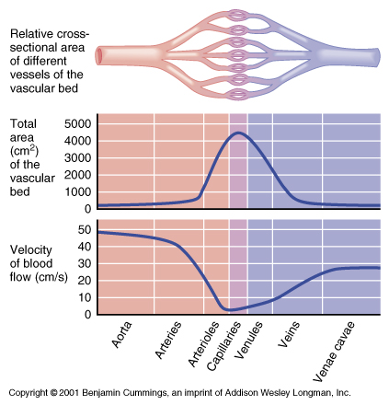
Velocity of Blood Flow
Blood velocity:
  Changes as it travels through the systemic circulation
  Is inversely proportional to the cross-sectional area
Slow capillary flow allows adequate time for exchange between blood and tissues

Slide 125
Autoregulation: Local Regulation of Blood Flow
Autoregulation – automatic adjustment of blood flow to each tissue in proportion to its requirements at any given point in time
Blood flow through an individual organ is intrinsically controlled by modifying the diameter of local arterioles feeding its capillaries
MAP remains constant, while local demands regulate the amount of blood delivered to various areas according to need

Slide 126
Intrinsic Control of Blood Flow: Metabolic
Declining tissue nutrient and oxygen levels are stimuli for autoregulation
Hemoglobin delivers nitric oxide (NO) as well as oxygen to tissues
Nitric oxide induces vasodilation at the capillaries to help get oxygen to tissue cells
Other autoregulatory substances include: potassium and hydrogen ions, adenosine, lactic acid, histamines, kinins, and prostaglandins

Slide 127
Intrinsic Control of Blood Flow: Myogenic
Inadequate blood perfusion or excessively high arterial pressure:
  Are autoregulatory
  Provoke myogenic responses – stimulation of vascular smooth muscle
Vascular muscle responds directly to:
  Increased vascular pressure with increased tone, which causes vasoconstriction
  Reduced stretch with vasodilation, which promotes increased blood flow to the tissue

Slide 128
Long-Term Autoregulation
Is evoked when short-term autoregulation cannot meet tissue nutrient requirements
May evolve over weeks or months to enrich local blood flow
Angiogenesis takes place:
  As the number of vessels to a region increases
  When existing vessels enlarge
  When a heart vessel becomes partly occluded
  Routinely to people in high altitudes, where oxygen content of the air is low

Slide 129
Capillary Exchange of Respiratory Gases and Nutrients
Oxygen, carbon dioxide, nutrients, and metabolic wastes diffuse between the blood and interstitial fluid along concentration gradients
  Oxygen and nutrients pass from the blood to tissues
  Carbon dioxide and metabolic wastes pass from tissues to the blood
  Water-soluble solutes pass through clefts and fenestrations
  Lipid-soluble molecules diffuse directly through endothelial membranes

Slide 130
Capillary Exchange: Fluid Movements
Direction of movement depends upon the difference between:
  Capillary hydrostatic pressure (HP_{c})
  Capillary colloid osmotic pressure (OP_{c})
HP_{c} – pressure of blood against the capillary walls:
  Tends to force fluids through the capillary walls
  Is greater at the arterial end of a bed than at the venule end
OP_{c}– created by nondiffusible plasma proteins, which draw water toward themselves

Slide 131
Net Filtration Pressure (NFP)
NFP – considers all the forces acting on a capillary bed
NFP = (HP_{c} – HP_{if}) – (OP_{c} – OP_{if})
At the arterial end of a bed, hydrostatic forces dominate (fluids flow out)
At the venous end of a bed, osmotic forces dominate (fluids flow in)
More fluids enter the tissue beds than return to the blood and the excess fluid is returned to the blood via the lymphatic system

Slide 132
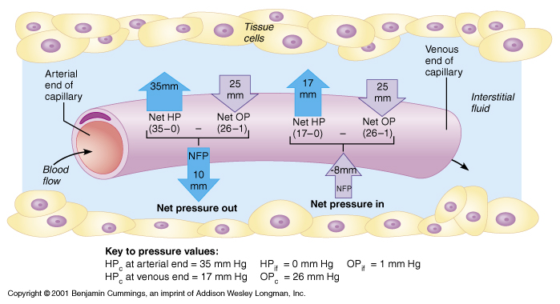
Net Filtration Pressure (NFP)

Slide 133
Circulatory Shock
Circulatory shock – any condition in which blood vessels are inadequately filled and blood cannot circulate normally
Results in inadequate blood flow to meet tissue needs
Three types include:
  Hypovolemic shock – results from large-scale blood loss
  Vascular shock – poor circulation resulting from extreme vasodilation
  Cardiogenic shock – the heart cannot sustain adequate circulation

Slide 134
Circulatory Pathways
The vascular system has two distinct circulations
  Pulmonary circulation – short loop that runs from the heart to the lungs and back to the heart
  Systemic circulation – routes blood through a long loop to all parts of the body and returns to the heart

Slide 135
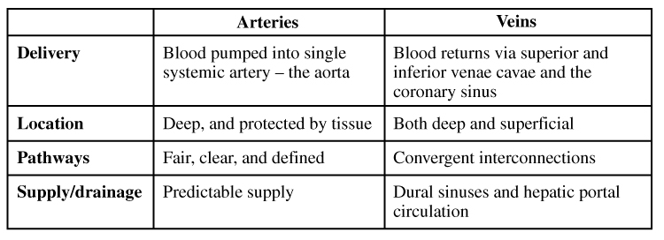
Differences Between Arteries and Veins

Slide 136
LYMPHATIC SYSTEM

Slide 137
Lymphatic System: Overview
Consists of two semi-independent parts
  A meandering network of lymphatic vessels
  Lymphoid tissues and organs scattered throughout the body
Returns interstitial fluid and leaked plasma proteins back to the blood
Lymph – interstitial fluid once it has entered lymphatic vessels

Slide 138
Lymphatic Vessels
A one-way system in which lymph flows toward the heart
Lymph vessels include:
  Microscopic, permeable, blind-ended capillaries
  Lymphatic collecting vessels
  Trunks and ducts

Slide 139
Lymphatic Capillaries
Similar to blood capillaries, with modifications
  Remarkably permeable
  Loosely joined endothelial minivalves
  Withstand interstitial pressure and remain open
The minivalves function as one-way gates that:
  Allow interstitial fluid to enter lymph capillaries
  Do not allow lymph to escape from the capillaries

Slide 140
Lymphatic Capillaries
During inflammation, lymphatic capillaries can absorb:
  Cell debris
  Pathogens
  Cancer cells
Cells in the lymph nodes:
  Cleanse and “examine” lymph
Lacteals – specialized lymph capillaries present in intestinal mucosa
  Absorb digested fat and deliver chyle to the blood

Slide 141
Lymphatic Collecting Vessels
Have the same three tunics as veins
Have thinner walls, with more internal valves
Anastomose more frequently
Collecting vessels in the skin travel with superficial veins
Deep vessels travel with arteries
Nutrients are supplied from branching vasa vasorum

Slide 142
Lymphatic Trunks
Lymphatic trunks are formed by the union of the largest collecting ducts
Major trunks include:
  Paired lumbar, bronchomediastinal, subclavian, and jugular trunks
  A single intestinal trunk
Lymph is delivered into one of two large ducts
  Right lymphatic duct – drains the right upper arm and the right side of the head and thorax
  Thoracic duct – arises from the cisterna chyli and drains the rest of the body

Slide 143
Lymphatic Transport
The lymphatic system lacks an organ that acts as a pump
Vessels are low pressure conduits
Uses the same methods as veins to propel lymph
  Pulsations of nearby arteries
  Contractions of smooth muscle in the walls of the lymphatics

Slide 144
Lymphoid Cells
Lymphocytes are the main cells involved in the immune response
The two main varieties are T cells and B cells

Slide 145
Lymphocytes
T cells and B cells protect the body against antigens
Antigen – anything the body perceives as foreign
  Bacteria and their toxins, and viruses
  Mismatched RBCs or cancer cells
T cells
  Manage the immune response
  Attack and destroy foreign cells
B cells
  Produce plasma cells, which secrete antibodies
  Antibodies immobilize antigens

Slide 146
Other Lymphoid Cells
Macrophages – phagocytize foreign substances and help activate T cells
Dendritic cells – spiny-looking cells with functions similar to macrophages
Reticular cells – fibroblastlike cells that produce a stroma, or network, that supports other cell types in lymphoid organs

Slide 147
Lymphoid Tissue
Diffuse lymphatic tissue – scattered reticular tissue elements in every body organ
  Larger collections appear in the lamina propria of mucous membranes and lymphoid organs
Lymphatic follicles (nodules) – solid, spherical bodies consisting of tightly packed reticular elements and cells
  Have a germinal center composed of dendritic cells and B cells
  Found in isolation and as part of larger lymphoid organs

Slide 148
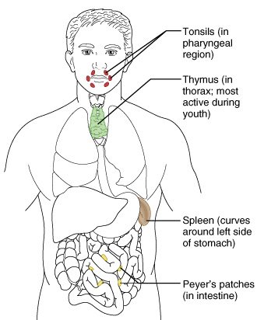
Lymphoid Organs
Lymphoid organs – discrete, encapsulated collections of diffuse lymphoid tissue and follicles
Examples include the lymph nodes, spleen, and thymus
Figure 19.5

Slide 149
Lymph Nodes
Nodes are imbedded in connective tissue and clustered along lymphatic vessels
Aggregations of these nodes occur near the body surface in inguinal, axillary, and cervical regions of the body
Their two basic functions are:
  Filtration – macrophages destroy microorganisms and debris
  Immune system activation – monitor for antigens and mount an attack against them

Slide 150
Circulation in the Lymph Nodes
Lymph enters via a number of afferent lymphatic vessels
It then enters a large subcapsular sinus and travels into a number of smaller sinuses
It meanders through these sinuses and exits the node at the hilus via efferent vessels
Because there are fewer efferent vessels, lymph stagnates somewhat in the node
  This allows lymphocytes and macrophages time to carry out their protective functions

Slide 151
Homeostatic Imbalances of the Lymph Nodes
If lymph nodes are overwhelmed by large numbers of antigen:
  They become inflamed and tender to the touch
    Such nodes are called buboes (or erroneously, swollen glands)
Nodes can also become secondary cancer sites
  Such nodes are swollen, but are not painful
    This distinguishes cancerous nodes from infected ones

Slide 152
Other Lymphoid Organs
The spleen, thymus gland, and tonsils
Peyer’s patches and bits of lymphatic tissue scattered in connective tissue
All are composed of reticular connective tissue and all help protect the body
Only lymph nodes filter lymph

Slide 153
Spleen
Largest lymphoid organ, located on the left side of the abdominal cavity beneath the diaphragm
It extends to curl around the anterior aspect of the stomach
It is served by the splenic artery and vein, which enter and exit at the hilus
Functions
  Site of lymphocyte proliferation
  Immune surveillance and response
  Cleanses the blood

Slide 154
Additional Spleen Functions
Stores breakdown products of RBCs
  Spleen macrophages salvage and store iron for later use by bone marrow
Site of fetal erythrocyte production (normally ceases after birth)
Stores blood platelets

Slide 155
Structure of the Spleen
Surrounded by a fibrous capsule, it has trabeculae that extend inward and contains lymphocytes, macrophages, and huge numbers of erythrocytes
Two distinct areas of the spleen are:
  White pulp – area containing mostly lymphocytes suspended on reticular fibers and involved in immune functions
  Red pulp – remaining splenic tissue concerned with disposing of worn-out RBCs and bloodborne pathogens

Slide 156
Thymus
A bilobed organ that secrets hormones (thymosin and thymopoietin) that cause T lymphocytes to become immunocompetent
The size of the thymus varies with age
  In infants, it is found in the inferior neck and extends into the mediastinum, where it partially overlies the heart
  It increases in size and is most active during childhood
  It stops growing during adolescence and then gradually atrophies

Slide 157
Thymus
The thymus differs from other lymphoid organs in important ways
  It functions strictly in T lymphocyte maturation
  It does not directly fight antigens
The stroma of the thymus consists of star-shaped epithelial cells (not reticular fibers)
These star-shaped thymocytes secret thymosins and thymopoietins that stimulate lymphocytes to become immunocompetent

Slide 158
Tonsils
Simplest lymphoid organs; form a ring of lymphatic tissue around the pharynx
Location of the tonsils
  Palatine tonsils – either side of the posterior end of the oral cavity
  Lingual tonsil – lies at the base of the tongue
  Pharyngeal tonsil – posterior wall of the nasopharynx
  Tubal tonsils – surround the openings of the auditory tubes into the pharynx

Slide 159
Tonsils
Lymphoid tissue of tonsils contains follicles with germinal centers
Tonsil masses are not fully encapsulated
Epithelial tissue overlying tonsil masses invaginates, forming blind-ended crypts
Crypts trap and destroy bacteria and particulate matter

Slide 160
Aggregates of Lymphoid Follicles
Peyer’s patches – isolated clusters of lymphoid tissue, similar to tonsils
  Found in the wall of the distal portion of the small intestine
  Similar structures are found in the appendix
Peyer’s patches and the appendix:
  Destroy bacteria, preventing them from breaching the intestinal wall
  Generate “memory” lymphocytes for long-term immunity

Slide 161
MALT
MALT – mucosa-associated lymphatic tissue, composed of:
  Peyer’s patches, tonsils, and the appendix (digestive tract)
  Lymphoid nodules in the wall of the bronchi (respiratory tract)
MALT protects the digestive and respiratory systems from foreign matter

Slide 162
THE IMMUNE SYSTEM
Innate and Adaptive
Body Defenses
Part D

Slide 163
Immunity: Two Intrinsic Defense Systems
Innate (nonspecific) system responds quickly and consists of:
  First line of defense – intact skin and mucosae prevent entry of microorganisms
  Second line of defense – antimicrobial proteins, phagocytes, and other cells
    Inhibit invaders spread throughout the body
    Inflammation is its hallmark and most important mechanism

Slide 164
Immunity: Two Intrinsic Defense Systems
Adaptive (specific) defense system
  Third line of defense – mounts attack against particular foreign substances
    Takes longer to react than the innate system
    Works in conjunction with the innate system

Slide 165
Surface Barriers
Skin, mucous membranes, and their secretions make up the first line of defense
Keratin in the skin:
  Presents a formidable physical barrier to most microorganisms
  Is resistant to weak acids and bases, bacterial enzymes, and toxins
Mucosae provide similar mechanical barriers

Slide 166
Epithelial Chemical Barriers
Epithelial membranes produce protective chemicals that destroy microorganisms
  Skin acidity (pH of 3 to 5) inhibits bacterial growth
  Sebum contains chemicals toxic to bacteria
  Stomach mucosae secrete concentrated HCl and protein-digesting enzymes
  Saliva and lacrimal fluid contain lysozyme
  Mucus traps microorganisms that enter the digestive and respiratory systems

Slide 167
Internal Defenses: Cells and Chemicals
The body uses nonspecific cellular and chemical devices to protect itself
  Phagocytes and natural killer (NK) cells
  Antimicrobial proteins in blood and tissue fluid
  Inflammatory response enlists macrophages, mast cells, WBCs, and chemicals
Harmful substances are identified by surface carbohydrates unique to infectious organisms

Slide 168
Phagocytes
Macrophages are the chief phagocytic cells
Free macrophages wander throughout a region in search of cellular debris
Kupffer cells (liver) and microglia (brain) are fixed macrophages
Neutrophils become phagocytic when encountering infectious material
Eosinophils are weakly phagocytic against parasitic worms
Mast cells bind and ingest a wide range of bacteria

Slide 169
Mechanism of Phagocytosis
Microbes adhere to the phagocyte
Pseudopods engulf the particle (antigen) into a phagosome
Phagosomes fuse with a lysosome to form a phagolysosome
Microbes in the phagolysosome are enzymatically digested
Indigestible and residual material is removed by exocytosis

Slide 170
Natural Killer (NK) Cells
Cells that can lyse and kill cancer cells and virus-infected cells
Natural killer cells:
  Are a small, distinct group of large granular lymphocytes
  React nonspecifically and eliminate cancerous and virus-infected cells
  Kill their target cells by releasing cytolytic chemicals
  Secrete potent chemicals that enhance the inflammatory response

Slide 171
Inflammation: Tissue Response to Injury
The inflammatory response is triggered whenever body tissues are injured
  Prevents the spread of damaging agents to nearby tissues
  Disposes of cell debris and pathogens
  Sets the stage for repair processes
The four cardinal signs of acute inflammation are redness, heat, swelling, and pain

Slide 172
Inflammatory Response
Begins with a flood of inflammatory chemicals released into the extracellular fluid
Inflammatory mediators:
  Include kinins, prostaglandins (PGs), complement, and cytokines
  Are released by injured tissue, phagocytes, lymphocytes, and mast cells
  Cause local small blood vessels to dilate, resulting in hyperemia

Slide 173
Inflammatory Response: Vascular Permeability
Chemicals liberated by the inflammatory response increase the permeability of local capillaries
Exudate (fluid containing proteins, clotting factors, and antibodies):
  Seeps into tissue spaces causing local edema (swelling)
  The edema contributes to the sensation of pain

Slide 174
Inflammatory Response: Edema
The surge of protein-rich fluids into tissue spaces (edema):
  Helps to dilute harmful substances
  Brings in large quantities of oxygen and nutrients needed for repair
  Allows entry of clotting proteins, which prevent the spread of bacteria

Slide 175
Inflammatory Response: Phagocytic Mobilization
Occurs in four main phases:
  Leukocytosis – neutrophils are released from the bone marrow in response to leukocytosis-inducing factors released by injured cells
  Margination – neutrophils cling to the walls of capillaries in the injured area
  Diapedesis – neutrophils squeeze through capillary walls and begin phagocytosis
  Chemotaxis – inflammatory chemicals attract neutrophils to the injury site

Slide 176
Antimicrobial Proteins
Enhance the innate defenses by:
  Attacking microorganisms directly
  Hindering microorganisms’ ability to reproduce
The most important antimicrobial proteins are:
  Interferon
  Complement proteins

Slide 177
Complement
20 or so proteins that circulate in the blood in an inactive form
Proteins include C1 through C9, factors B, D, and P, and regulatory proteins
Provides a major mechanism for destroying foreign substances in the body
Amplifies all aspects of the inflammatory response
Kills bacteria and certain other cell types (our cells are immune to complement)
Enhances the effectiveness of both nonspecific and specific defenses

Slide 178
Adaptive (Specific) Defenses
The adaptive immune system is a functional system that:
  Recognizes specific foreign substances
  Acts to immobilize, neutralize, or destroy them
  Amplifies inflammatory response and activates complement
The adaptive immune system is antigen-specific, systemic, and has memory
It has two separate but overlapping arms
  Humoral, or antibody-mediated immunity
  Cellular, or cell-mediated immunity

Slide 179
Cells of the Adaptive Immune System
Two types of lymphocytes
  B lymphocytes – oversee humoral immunity
  T lymphocytes – non-antibody-producing cells that constitute the cell-mediated arm of immunity
Antigen-presenting cells (APCs):
  Do not respond to specific antigens
  Play essential auxiliary roles in immunity

Slide 180
Lymphocytes
Immature lymphocytes released from bone marrow are essentially identical
Whether a lymphocyte matures into a B cell or a T cell depends on where in the body it becomes immunocompetent
  B cells mature in the bone marrow
  T cells mature in the thymus

Slide 181
T Cells and B Cells
T cells mature in the thymus under negative and positive selection pressures
  Negative selection – eliminates T cells that are strongly anti-self
  Positive selection – selects T cells with a weak response to self-antigens, which thus become both immunocompetent and self-tolerant
B cells become immunocompetent and self-tolerant in bone marrow

Slide 182
Immunocompetent B or T cells
Display a unique type of receptor that responds to a distinct antigen
Become immunocompetent before they encounter antigens they may later attack
Are exported to secondary lymphoid tissue where encounters with antigens occur
Mature into fully functional antigen-activated cells upon binding with their recognized antigen
It is genes, not antigen, that determine which foreign substance our immune system will recognize and resist

Slide 183
Antigen-Presenting Cells (APCs)
Major rolls in immunity are:
  To engulf foreign particles
  To present fragment of antigens on their own surfaces, to be recognized by T cells
Major APCs are dendritic cells (DCs), macrophages, and activated B cells
The major initiators of adaptive immunity are DCs, which actively migrate to the lymph nodes and secondary lymphoid organs and present antigens to T and B cells

Slide 184
Macrophages and Dendritic Cells
Secrete soluble proteins that activate T cells
Activated T cells in turn release chemicals that:
  Rev up the maturation and mobilization of DCs
  Prod macrophages to become activated macrophages, which are insatiable phagocytes and release bactericidal chemicals

Slide 185
Humoral Immunity Response
Antigen challenge – first encounter between and antigen and a naive immunocompetent cell
Takes place in the spleen or other lymphoid organ
If the lymphocyte is a B cell:
  The challenging antigen provokes a humoral immune response
    Antibodies are produced against the challenger

Slide 186
Active Humoral Immunity
B cells encounter antigens and produce antibodies against them
  Naturally acquired – response to a bacterial or viral infection
  Artificially acquired – response to a vaccine of dead or attenuated pathogens
Vaccines – spare us the symptoms of disease, and their weakened antigens provide antigenic determinants that are immunogenic and reactive

Slide 187
Passive Humoral Immunity
Differs from active immunity in the antibody source and the degree of protection
  B cells are not challenged by antigen
  Immunological memory does not occur
  Protection ends when antigens naturally degrade in the body
Naturally acquired – from the mother to her fetus via the placenta
Artificially acquired – from the injection of serum, such as gamma globulin

Slide 188
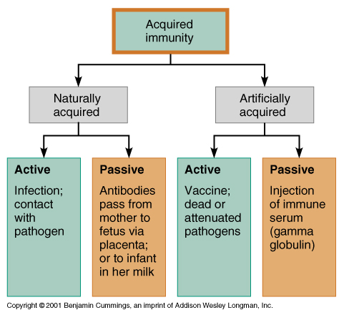
Acquired Immunity

Slide 189
Cell-Mediated Immune Response
Since antibodies are useless against intracellular antigens, cell-mediated immunity is needed
Two major populations of T cells mediate cellular immunity
  CD4 cells (T4 cells) are primarily helper T cells (T_{H})
  CD8 cells (T8 cells) are cytotoxic T cells (T_{C}) that destroy cells harboring foreign antigens
Other types of T cells are:
  Delayed hypersensitivity T cells (T_{DH})
  Suppressor T cells (T_{S})
  Memory T cells

Slide 190
Immunodeficiencies
Congenital and acquired conditions in which the function or production of immune cells, phagocytes, or complement is abnormal
  SCID – severe combined immunodeficiency (SCID) syndromes; genetic defects that produce:
    A marked deficit in B and T cells
    Abnormalities in interleukin receptors
    Defective adenosine deaminase (ADA) enzymes
      Metabolites lethal to T cells accumulate
  SCID is fatal if untreated; treatment is with bone marrow transplants

Slide 191
Acquired Immunodeficiencies
Hodgkin’s disease – cancer of the lymph nodes leads to immunodeficiency by depressing lymph node cells
Acquired immune deficiency syndrome (AIDS) – cripples the immune system by interfering with the activity of helper T (CD4) cells
  Characterized by severe weight loss, night sweats, and swollen lymph nodes
  Opportunistic infections occur, including pneumocystis pneumonia and Kaposi’s sarcoma

Slide 192
AIDS
Caused by human immunodeficiency virus (HIV) transmitted via body fluids – blood, semen, and vaginal secretions
HIV enters the body via:
  Blood transfusions
  Contaminated needles
  Intimate sexual contact, including oral sex
HIV:
  Destroys T_{H} cells
  Depresses cell-mediated immunity

Slide 193
AIDS
HIV multiplies in lymph nodes throughout the asymptomatic period
Symptoms appear in a few months to 10 years
Attachment
  HIV’s coat protein (gp120) attaches to the CD4 receptor
  A nearby protein (gp41) fuses the virus to the target cell
HIV enters the cell and uses reverse transcriptase to produce DNA from viral RNA
This DNA (provirus) directs the host cell to make viral RNA (and proteins), enabling the virus to reproduce and infect other cells

Slide 194
AIDS
HIV reverse transcriptase is not accurate and produces frequent transcription errors
  This high mutation rate causes resistance to drugs
Treatments include:
  Reverse transcriptase inhibitors (AZT)
  Protease inhibitors (saquinavir and ritonavir)
  New drugs that are currently being developed, which block HIV’s entry to helper T cells

Slide 195
Autoimmune Diseases
Loss of the immune system’s ability to distinguish self from nonself
The body produces autoantibodies and sensitized T_{C} cells that destroy its own tissues
Examples include multiple sclerosis, myasthenia gravis, Graves’ disease, Type I (juvenile) diabetes mellitus, systemic lupus erythematosus (SLE), glomerulonephritis, and rheumatoid arthritis

